Slide 1


RATINGS PREDICTION
Presented By:
SUMAIR DHIR

Slide 2

PROBLEM STATEMENT
We have a client who has a website where people write different reviews for technical products. Now they are adding a new feature to their website i.e. The reviewer will have to add stars(rating) as well with the review.
The rating is out 5 stars and it only has 5 options available 1 star, 2 stars, 3 stars, 4 stars, 5 stars. Now they want to predict ratings for the reviews which were written in the past and they don’t have a rating.
So, we have to build an application which can predict the rating by seeing the review.

Slide 3
EDA STEPS
We will start by importing the libraries that we require for performing EDA. These include NumPy, Pandas, Matplotlib, and Seaborn for visualization, handling dataset and mathematic computation.
We will now read the data from CSV files into a Pandas DataFrame.
We will display top 5 rows of data by using .head() function to know if it has the right type to data in it or not.
Using .shape function to display total number of rows and columns present in the dataset.
Using .columns function to display all the features name present in the dataset.
We will now check datatype of each variables of data by using .info() function.
Checking number of unique elements present in the features/variables.

Slide 4
Use describe() function to get statistical details like count, percentiles, mean, std, and maximum value of a train and test data.
We will now check for null values in the dataset. We will use isnull().sum() function. But the dataset has no null values.
Target dataset is highly imbalanced when visualized through plotting.
Cleaned the reviews column data using regex, removed stopwords, special characters, punctuations etc by defining function text cleaner.
Tokenizing the data using RegexpTokenizer
Getting sense of loud words for all ratings using WordCloud.

Slide 5
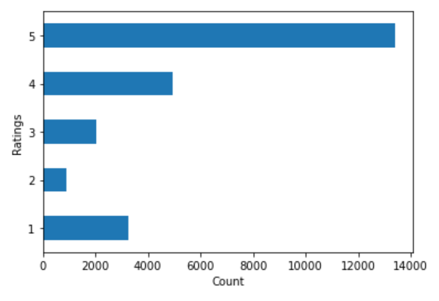
VISUALIZATIONS
Count of Ratings done by consumers :
Rated 5 – 13421
Rated 4 – 4931
Rated 3 – 2037
Rated 2 – 914
Rated 1 – 3254
Target dataset is imbalanced

Slide 6
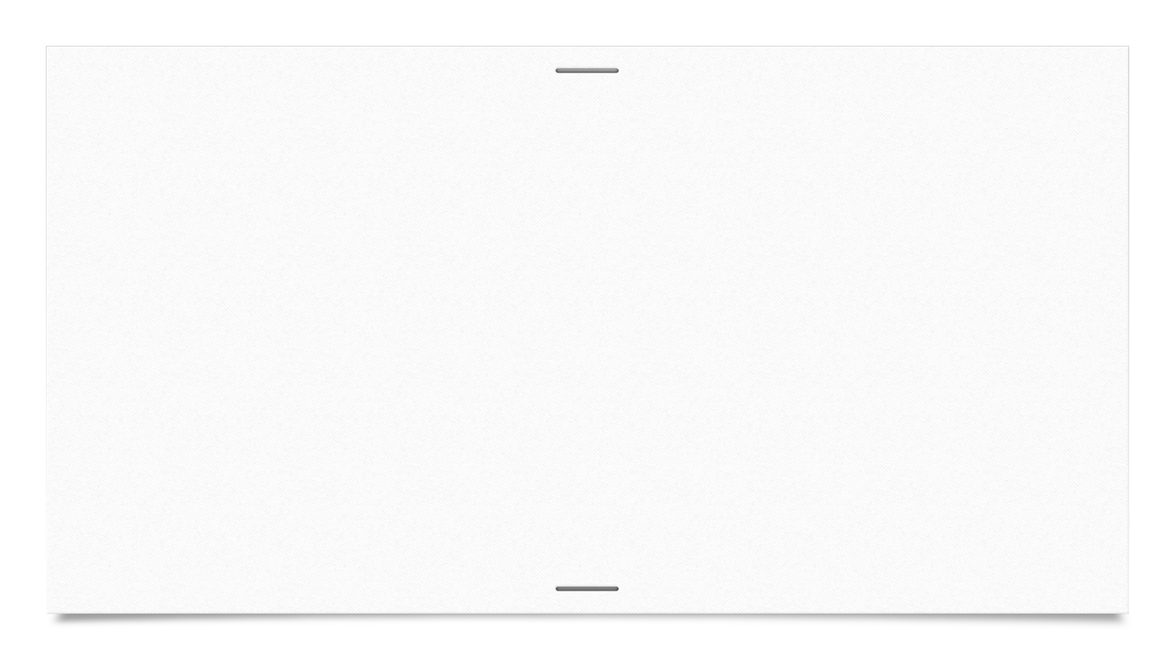

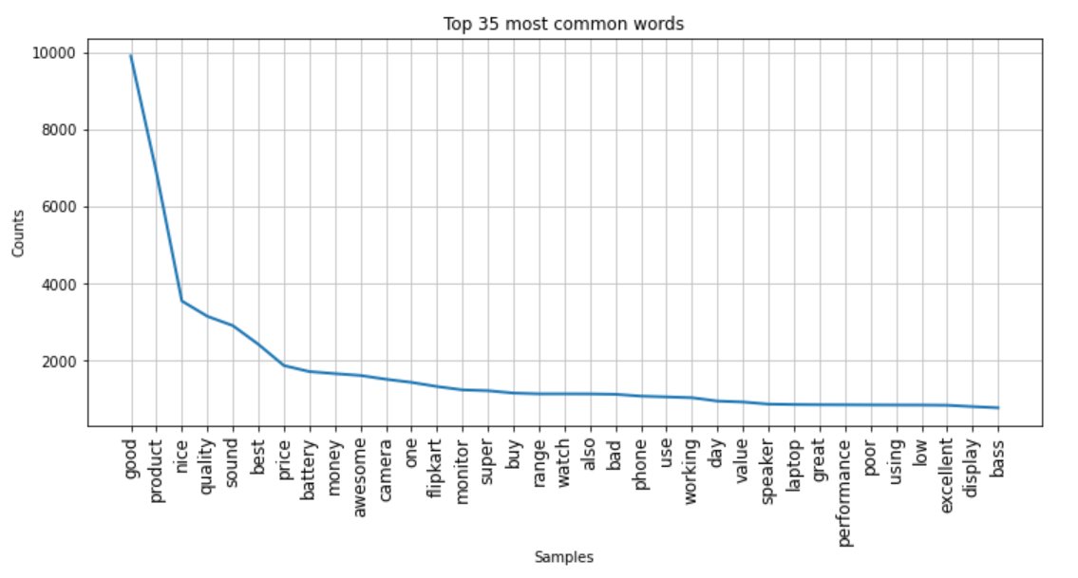
These are 35 most frequently used common words from the Cleaned Full Reviews column according to its number of occurrences in a descending order.

Slide 7
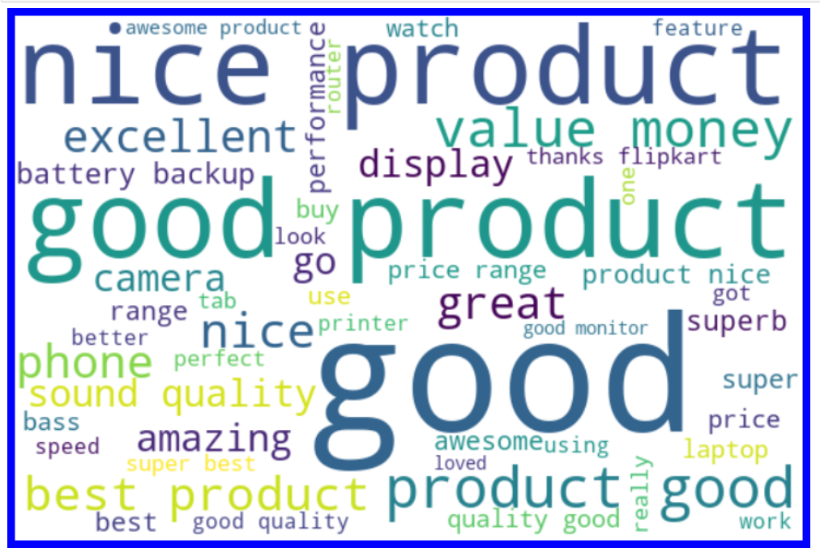
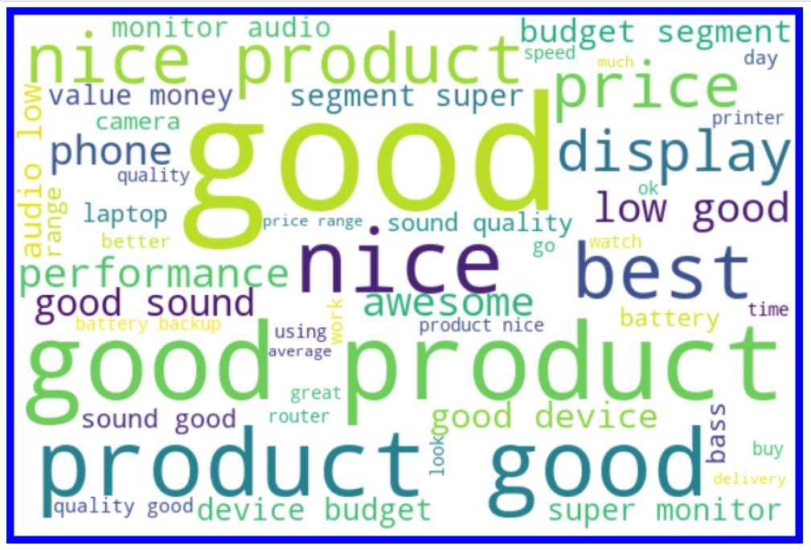
Words appearing frequently that is rated 5 by Consumers
Words appearing frequently that is rated 4 by Consumers

Slide 8
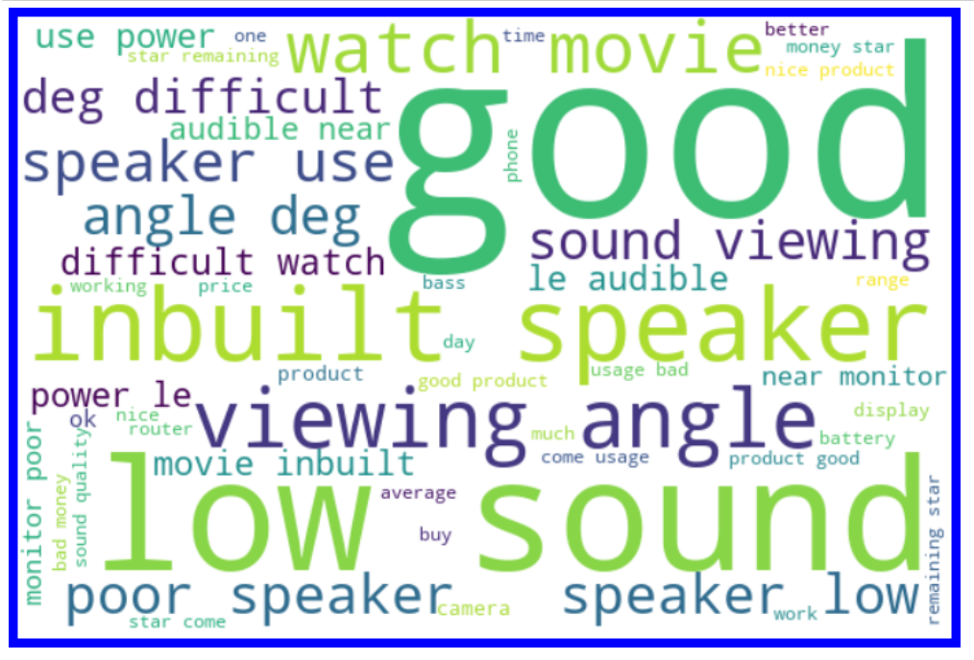
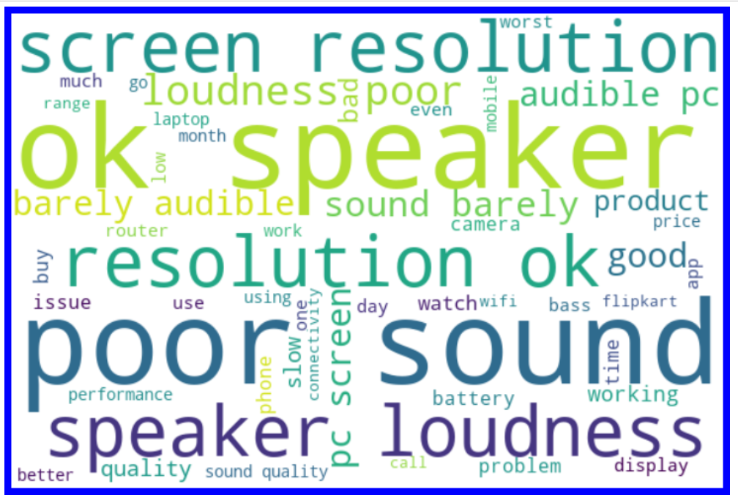
Words appearing frequently that is rated 3 by Consumers
Words appearing frequently that is rated 2 by Consumers

Slide 9
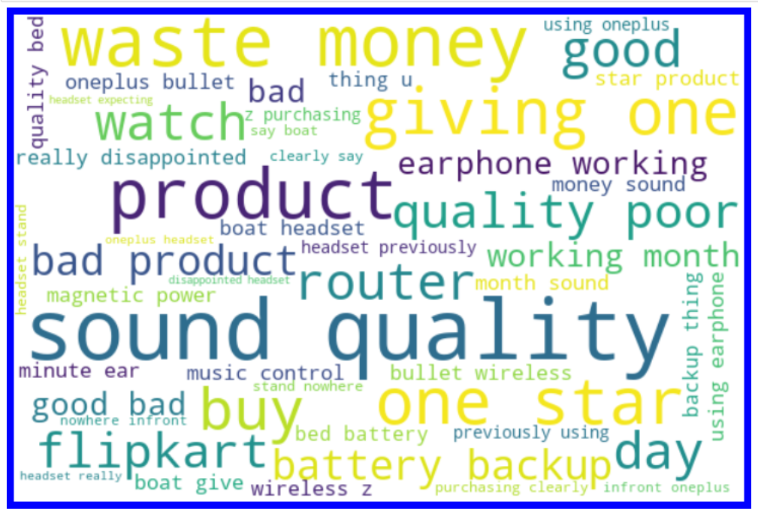
Words appearing frequently that is rated 1 by Consumers

Slide 10
Imported RegEx for matching set of strings, installed nltk library to download stopword packages, also used lemmatizer for converting words to its base form.
Imported wordcloud to visualize sense of loud words appearing more frequently.
Converted all Cleaned_Full Reviews column texts into lower case, then removed punctuations, digits, stopwords from it.
Dropped Full Reviews column as the elements in it after preprocessing was stored in Cleaned_Full Reviews column.
Creating a feature named label and storing all the target columns in it.
Converting data texts into vectors using TfidfVectorizer.
Using SMOTE (resampling) method to cope up with imbalanced classification of target variable.
Then started model building and testing with different algorithms to find best model and finally doing hyper parameter tuning to achieve good accuracy.
STEPS & ASSUMPTIONS TAKEN

Slide 11
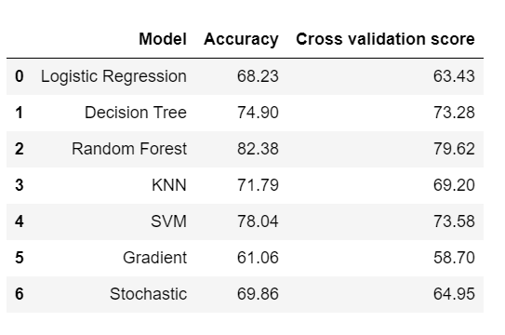
FINALIZED MODEL
Decision Tree Classifier model is our best/finalized model because the difference between its accuracy and CV score is least among all models.
After applying hyper parameter tuning on our best model (Decision Tree) , the accuracy is approximately the same.

Slide 12
CONCLUSION
Our model performs reasonably well on 1,4 and 5-star ratings and relatively bad on 2 and 3-star ratings.
Ratings 5 : Words like perfect, nice, best, excellent, good has been mostly used.
Ratings 4 : Words like good, nice, best, better has been mostly used
Ratings 3 : Words like average, low, poor, difficult has been mostly used
Ratings 2 : Words like slow, poor, barely, problem has been mostly used
Ratings 1 : Words like bad, disappointed, poor, one star has been mostly used
The analysis also reveals that the user reviews are inconsistent with user numeric ratings, and that numeric ratings are higher than user reviews might suggest.
Some of the reviews were bad and the texts had more wrong information about the product.
Results demonstrate that tree-based bagging ensemble classifiers perform much better than boosting-based classifiers on account of their support for nonlinearity, colinearity, and tolerance to data noise.

Slide 13
THANK YOU!

